Slide 1
Forecasting ESG score Based on 10-K Annual Reports
20240419 TEN MFS.key

Slide 2
Purpose of this project
Data Introduction
EDA
Feature selection
Model selection
Training and Testing
Performance
Prediction

Slide 3
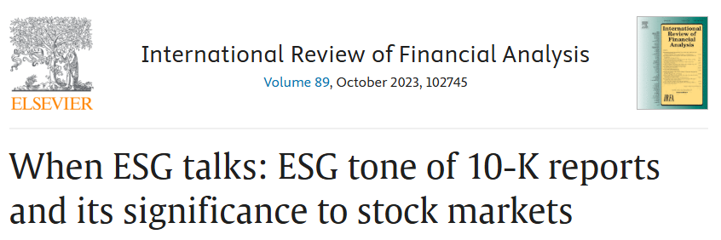
Purpose of this project -> Predict company 2024 ESG score
Company ESG score has positive relationship with stock performance
Predict company ESG score by 10K annual report
Title

Slide 4
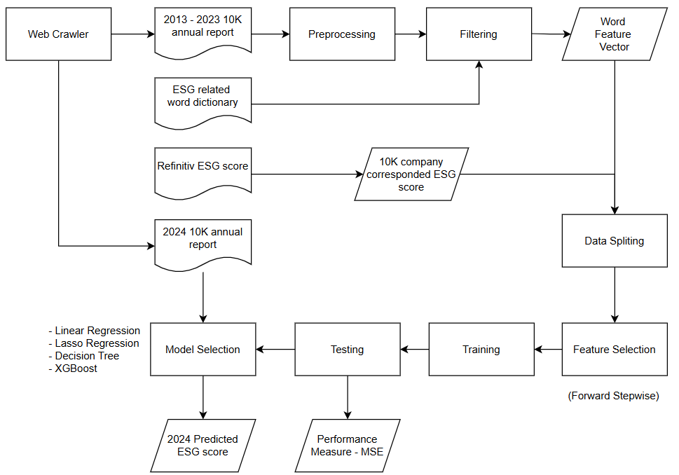
Flow Chart
Flowchart

Slide 5
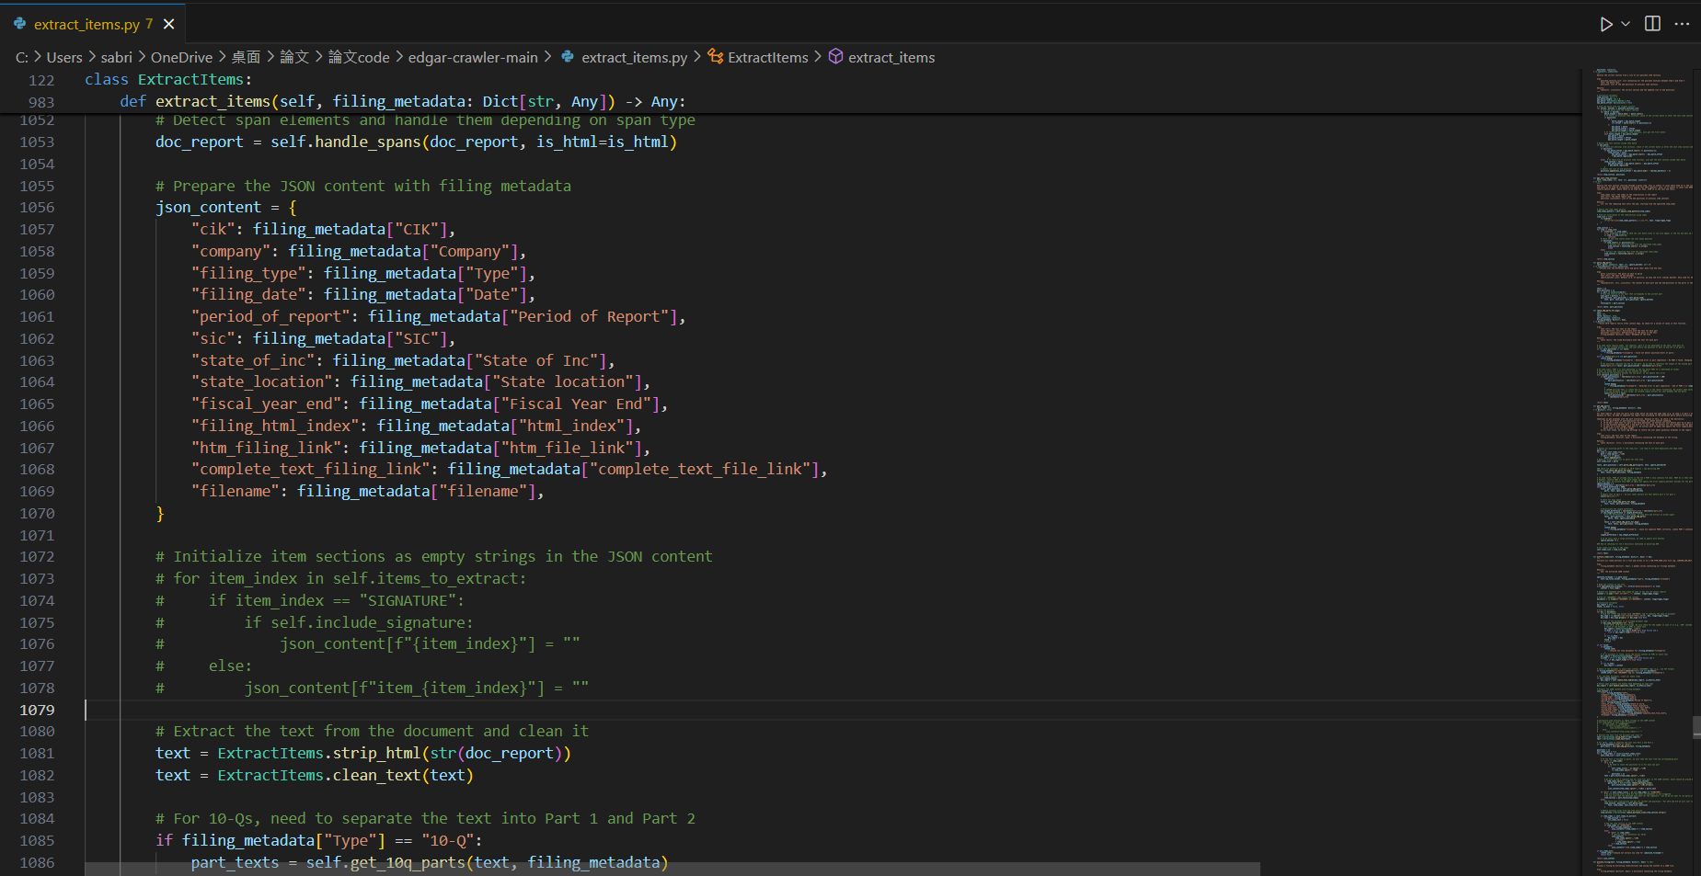
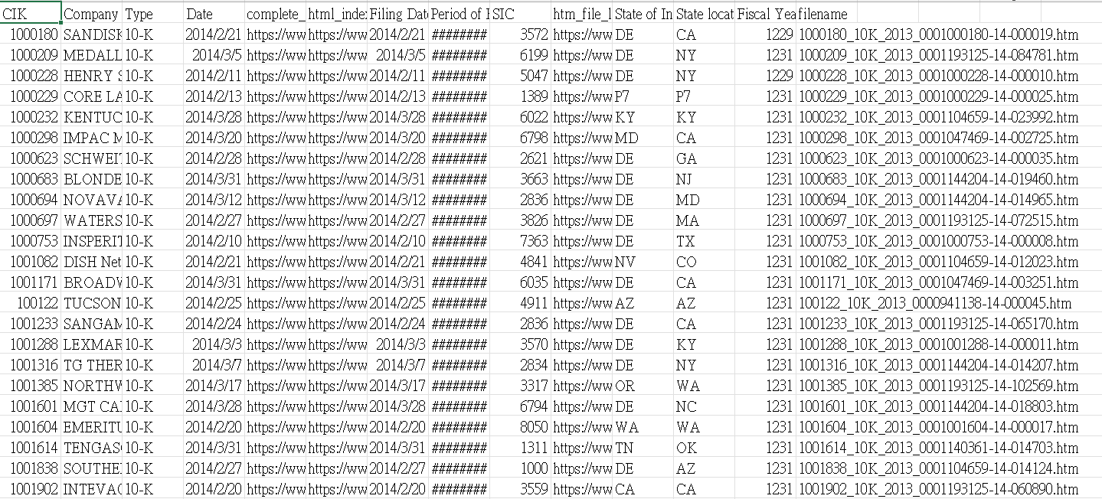
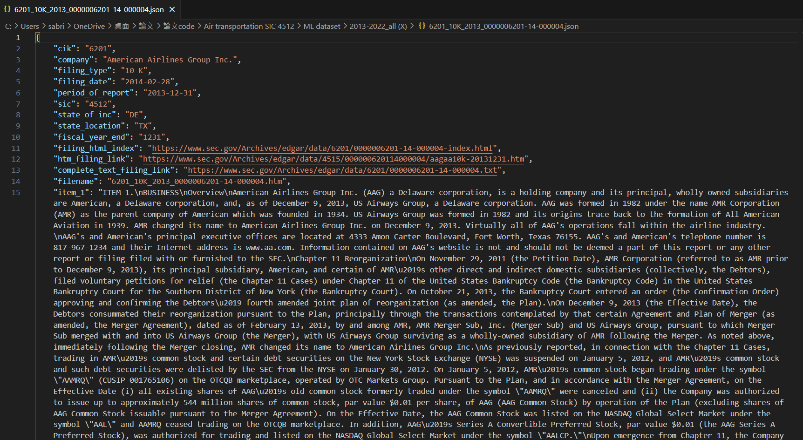
Method
Web crawling
Collect target companies’ 10K annual report from SEC website
Target：US airline industry
Title

Slide 6
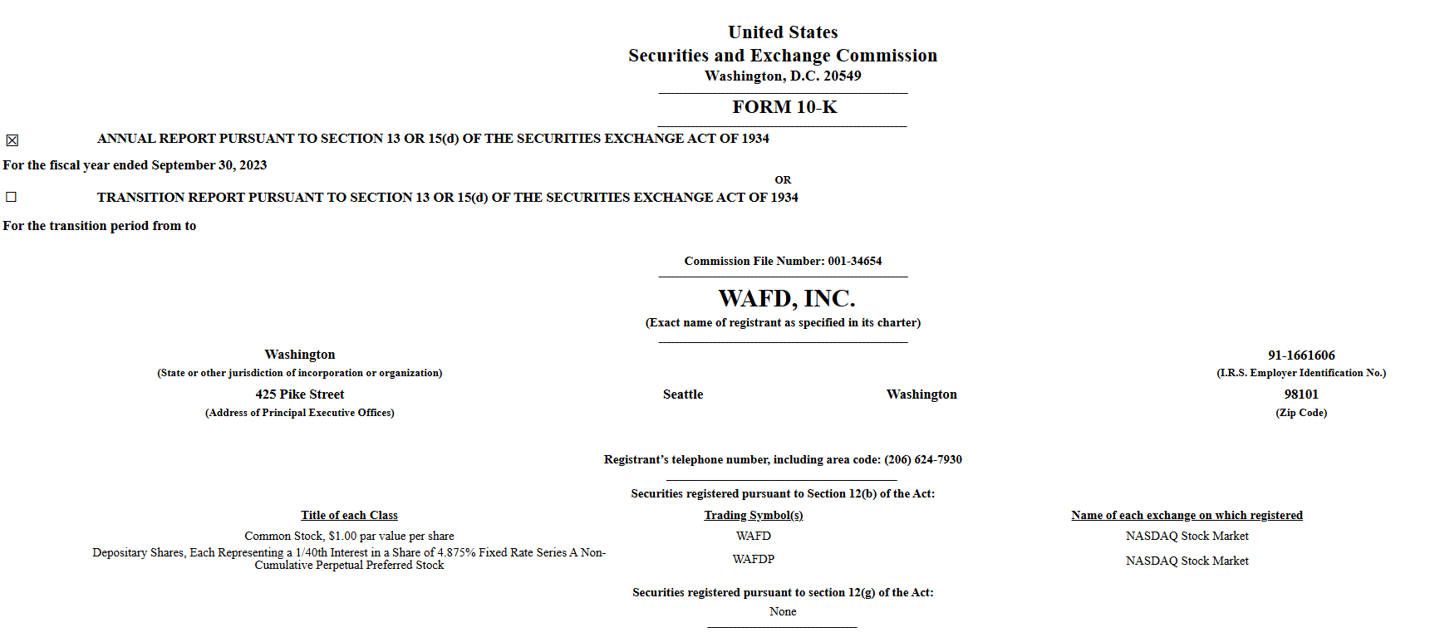
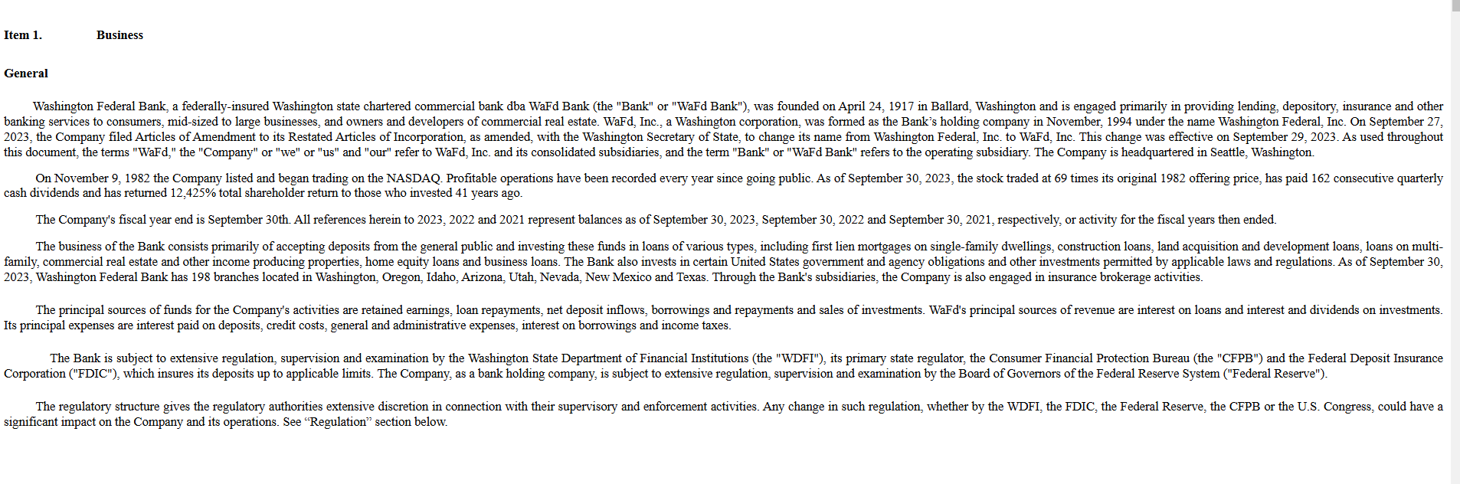
Method
Data Introduction
10K annual report (2013-2024)
Refinitiv ESG score(2013-2024) (scoring from 0-100)s
ESG wordlist (Baier et al. (2020))
Title

Slide 7
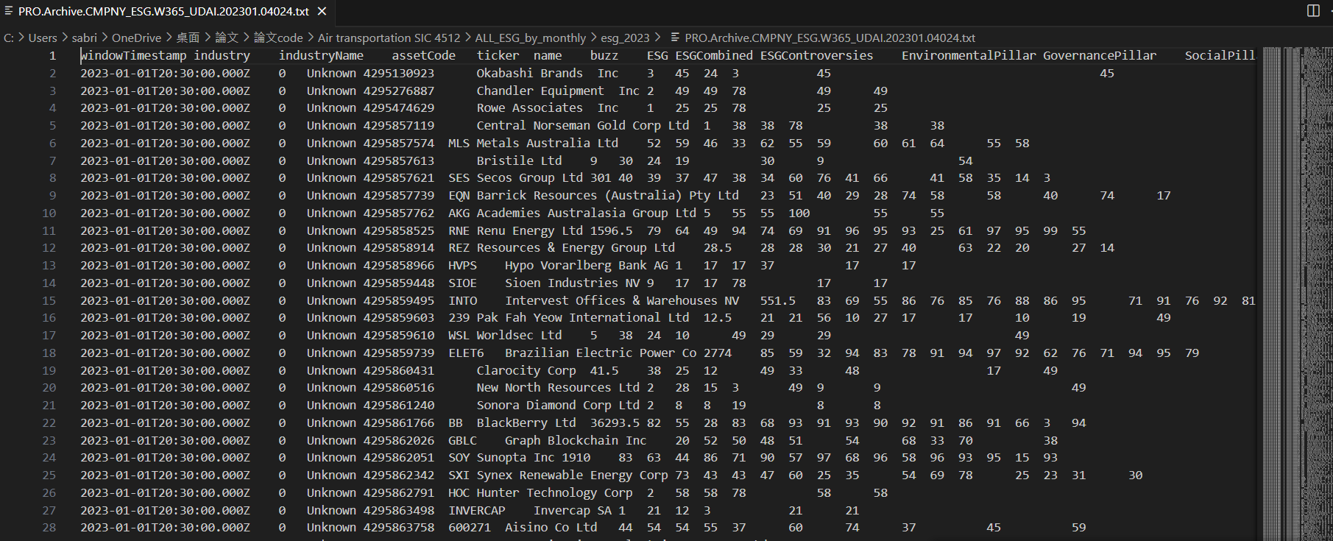
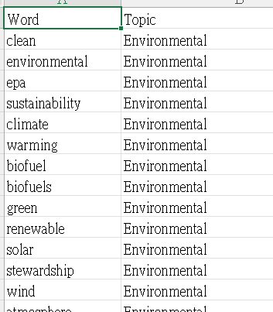
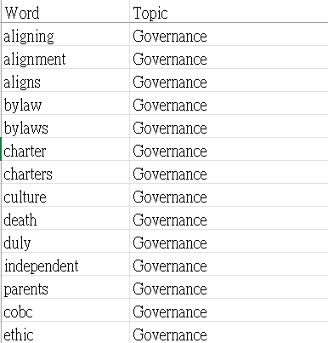
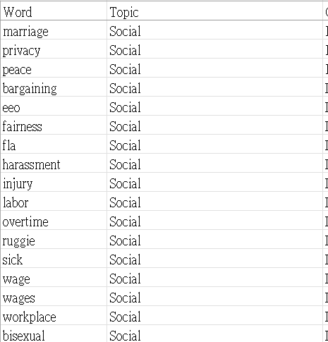

Method
Data Introduction
Title

Slide 8
Method
Data Preprocessing
For 10K：
# Decode any Unicode escape sequences
# Remove numbers
# Replace multiple spaces with a single space
# Lowercasing
# Remove punctuation
# Remove stopwords and lemmatize
# Filter the text using ESG Dictionary
For Refinitiv ESG score
# Averaging monthly score to annual score for every target company
Title

Slide 9
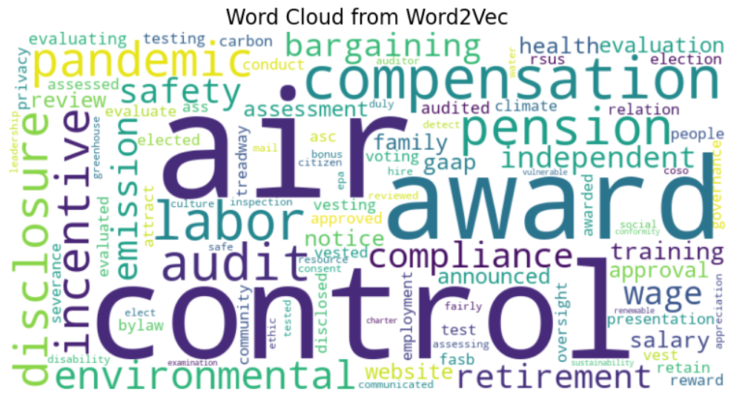
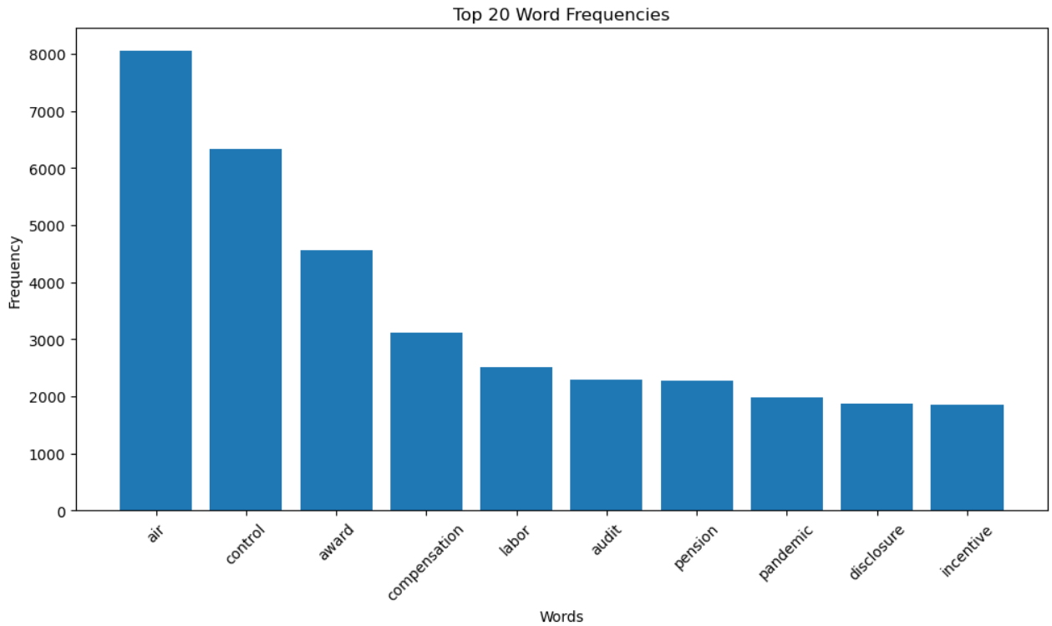
Method
EDA
Title

Slide 10
Method
Embedding and Parameter Setting
Using Word2vec to create word feature vector
Date split：80% train data, 20% test data
Feature Selection： forward stepwise
Title

Slide 11
Method
Model Selection
Linear Regression Test MSE: 317.68
Lasso Regression Test MSE: 39.80
Decision Tree Test MSE: 101.61
XGBoost Test MSE : 46.01
Title

Slide 12
Method
ESG Score Prediction (Using Lasso Regression)
American Airlines Group Inc. ：88.68
DELTA AIR LINES INC /DE/ ：72.00
SOUTHWEST AIRLINES CO ：67.22
United Continental Holdings, Inc. ：52.93
ALASKA AIR GROUP, INC. ：59.57
SKYWEST INC ：48.25
JETBLUE AIRWAYS CORP：51.5
Spirit Airlines, Inc.：75.5
Title

Slide 13
Thanks for listening
Title

